Slide 1

BOARD OF DIRECTORS
ROLES AND RESPONSIBILITIES
and BEYOND

Slide 2
Today’s Plan
TELL US ABOUT YOU
THESE ARE THE LAWS OF YOUR ORGANIZATION
HOW DOES EACH MEMBER BRING ADDED VALUE?
MEETINGS AND DECISIONS
QUESTIONS AND DISCUSSION
INTRODUCTION
THE LAW
THE BYLAWS
ADDING VALUE
WHO DOES WHAT AND HOW ARE DECISIONS MADE?
WHAT LAWS IMPACT NOT-FOR-PROFITS IN QUEBEC AND WHAT DO THEY SAY?

Slide 3
INTRODUCTIONS

Slide 4
PLEASE TELL US…
Your Name
Your Organization (the one where you govern)
How long you have been a board member
If you sit on other boards now or if you have in the past
What you are hoping to learn today
Your favourite flavour of ice cream

Slide 5

WHO ARE WE?

Slide 6
OBJECTIVES
BY THE END OF TODAY’S SESSION, YOU WILL…
LEARN SOMETHING NEW ABOUT YOUR FELLOW BOARD MEMBERS
UNDERSTAND GOOD GOVERNANCE AND THE DIFFERENT MODELS OF GOVERNANCE
BE ABLE TO LIST THE LEGAL OBLIGATIONS OF BOARD MEMBERS IN QUEBEC
BETTER UNDERSTAND YOUR ROLE AS AN INDIVIDUAL BOARD MEMBER
GAIN PRACTICAL KNOWLEDGE ABOUT OPERATIONS ON THREE LEVELS
GAIN PRACTICAL TOOLS TO ENABLE YOU AND NEW BOARD MEMBERS TO ADD VALUE TO YOUR BOARD OF DIRECTORS AND TO YOUR ORGANIZATION
P

Slide 7

MEMBERS
BOARD
STAFF
Notes:
Characteristics include TRUST, RESPECT, GOOD FAITH, FREE OF CONFLICT and communicating regularly with the members who elected you. Best use of resources and mechanisms to ensure they are well spent. CARVER MODEL allows for this approach to good governance.
Even in electing board members, the general assembly of members maintains certain powers, which include electing board members, selecting auditors and amending certain bylaws.
Powers of board members include amending certain bylaws, administering the org or delegating powers to someone to administer and adopting resolutions to administer the legal person.

Slide 8

THE LAW

Slide 9

Which laws govern your not-for profit organization?
COMPANIES ACT
LANGUAGE LAWS
TAX LAWS
LABOUR LAWS
CONSUMER PROTECTION
PROFESSIONAL ORDERS
Notes:
Most of our training will be focused on the powers and responsibilities of board members identified in the companies act. However, it is important for board members to have a general idea of the other laws that may impact the organization. With regards to details related to these laws, it is best to hire a competent, knowledgeable executive director who will make you look good.
For example, your ED should ensure that income tax is deducted from employee salaries and paid to the government. Your ED should know that the new labour laws require organizations to have a specific harassment policy with clear guidelines on filing complaints and steps to be taken when a complaint is received. There are other laws that may impact your specific organization, none I can think of for your organizations, but if Seniors’ Respite Montérégie ever decides to offer residential services, then they will have to apply for a specific licence to do so. Some of your employees may belong to professional orders and there are certain laws they must abide by; these are important for you ED to be aware of and share any pertinent information with your board. The board may also decide to seek legal counsel on certain issues to protect itself and the organization from potentially legal action. For example, if the board is aware of a situation where an employee may be considering legal action for harassment, the board may seek legal counsel to ensure that any actions taken by the ED on behalf of the organization are within the parameters of the Quebec labour act.

Slide 10

Notes:
The notion of fiduciary responsibility stems from an organization being a legal entity, or a “legal person”, which cannot manage its own affairs. The management of its affairs is delegated to the board, which becomes the fiduciary.
The organization has certain tax benefits, can apply for funding to pursue its mission and has the responsibility to manage the funds received.
The legal person cannot buy its own land or organize its own activities to achieve its mission so it counts on the good people of the board to do this in the organization’s best interests and not the interest of the people around the table.
Signing contracts in good faith
No financial gain from the corporation

Slide 11
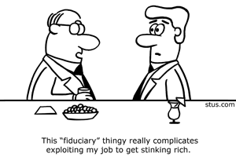
Notes:
What happened
Subject to inspections
When in doubt, investigate, otherwise trust

Slide 12

Achieving the mission
Part of your fiduciary responsibility
Notes:
SITUATION #1
At the last annual general meeting, a young nurse was elected to the board of Assistance & Referral Centre. The nurse arrives to the first board meeting without reading the minutes of the last meeting and without seeing the agenda. The nurse declares that the organization should offer a taxi service to the seniors and tells the executive director to purchase a minivan. The other board members say nothing because the young nurse seems to understand the needs of seniors in the Montérégie.

Slide 13


Who is legally responsible for…
Changing the mission?
Hiring an executive director?
Evaluating the executive director?
Selecting auditors?
Electing board members?
Organizing an annual general meeting?
Knowing the applicable laws?
Changing bylaws?
Keeping an eye on the vision and future of the organization?
Hiring staff?
Attending an annual general meeting?
Keeping records?
Signing contracts?
Keeping the Registre des entreprises updated?

Slide 14
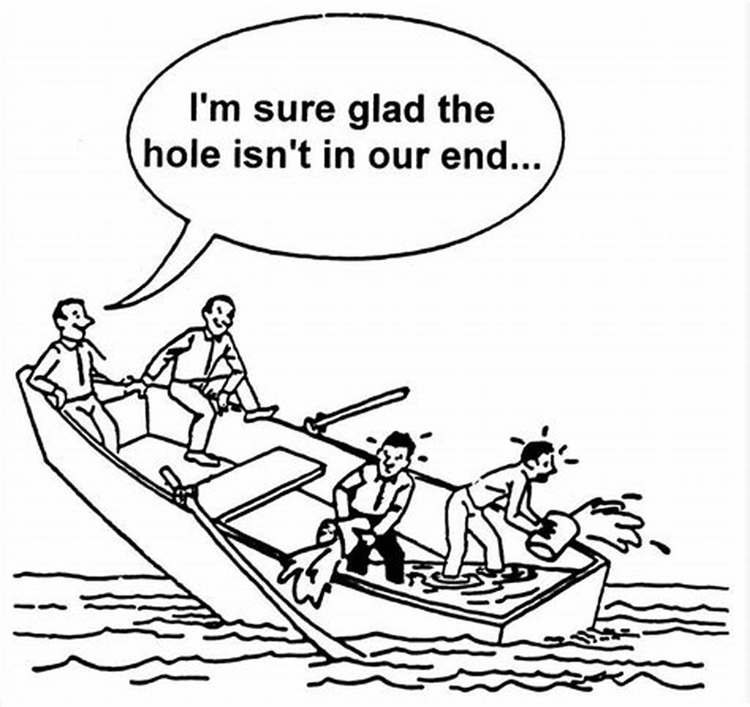
COLLECTIVE RESPONSIBILITY
Together, a board has great power
Individually, board members have great responsibility
Notes:
“I” can’t do anything as a board member. “We” can do a great deal together.

Slide 15



DELEGATION OF POWER
ACCOUNTABLITY
RESPONSIBILITY
AUTHORITY
BOARD
E.D.
COMMITTEE
TRUST
CLARIFY SCOPE OF POWER DELEGATED
CLEAR POLICIES
MINIMAL INTERFERENCE
TOLERANCE FOR ERRORS
CELEBRATE ACHIEVEMENTS
Notes:
1. Trust
2. Clear goals and objectives at the start of the delegation
3. Monitoring
4. Clear policies
5. Minimal interference
6. Tolerance of mistakes
7. Celebrate achievement of goals

Slide 16


Slide 17

HOW MUCH TO DELEGATE?
IT IS COMMON PRACTICE TO DELEGATE MOST OF THE BOARD’S ADMINISTRATIVE POWERS TO AN EXECUTIVE DIRECTOR.
HOW MUCH AUTHORITY DO YOU THINK THE ED SHOULD HAVE WITHOUT SEEKING BOARD APPROVAL?
$ 0
$ 50,000
$ 100,000

Slide 18
Conflict of interest
Am I deriving a personal advantage from my service on the board?
  Will I make money from this deal?
  Will I advance my career from this decision?
  Does anyone in my family stand to benefit?
The simple appearance of a conflict of interest is a conflict of interest you want to avoid as a board member.
  Can you think of any examples?
  There is a commonly used test to determine if there is a real or perceived conflict of interest:
  Have you heard of the…
May arise when personal interest is at odds with the interests of the organization
REMEMBER: Your fiduciary responsibility is to ensure the best interests of the LEGAL PERSON come first.
Notes:
According to DELIGENT.com: In a recent court case, a board member made use of inside information to make a profitable investment, without obtaining authorization from the board. He was obliged to repay much of the profit earned to the company for which he acted as a board member.

Slide 19


The Journal de Montréal Test?

Slide 20
Best practices in governance
Avoid
Conflict of interest
Ensure
Fiduciary responsibility
Uphold
Legal requirements
And that is each individual board member’s responsibility
Notes:
Ethics and equity, accountability, transparency and corporate responsibility (ensure orgs sustainability). The board must regularly evaluate itself in order to ensure ongoing good governance.
In addition, individual directors must:
• Respect the confidential nature of information acquired while serving as a director.
• Always put the organization’s interest first.
• Attend board meetings regularly and prepare appropriately.
• Declare any potential, real or perceived conflicts of interest.
• Speak positively about the organization and promote it to the public.
• Participate in fundraising activities and other general activities of the organization.

Slide 21

THE BYLAWS

Slide 22
MAIN TYPES OF BOARDS
Policy (Carver Model)
Advisory
Management
Collaborative
Notes:
Take time and give examples of each:
Advisory board: not common, but happens when founder is also first ED or president and wants to maintain power…could be potentially conflictual
Policy: most common and the one that seems to be used here…more to come on this one
Management: like at band council

Slide 23
LAWS
BYLAWS
RESOLUTIONS
POLICIES
PROCEDURES
Notes:
The law is the purview of the government and the board must abide by it.
The bylaws are the purview of the members of the general assembly, though recommendations for changes often come from the board and the board may implement certain changes immediately and not bring others for approval by the general assembly at all, as we will see shortly.
The resolutions are the laws created by the board for the administration of the organization.
The board can resolve to adopt policies to specify the administration.
These policies are translated into procedures, actions and daily management by the ED.

Slide 24
YOUR BOARD
THE TYPE OF BOARD IS USUALLY IDENTIFIED IN THE BYLAWS
BASED ON YOUR BYLAWS, YOU SEEM TO HAVE ADOPTED THE CARVER MODEL OF GOVERNANCE WHERE THE BOARD IS RESPONSIBLE FOR THE OVERALL ADMINISTRATION OF THE ORGANIZATION AND THE EXECUTIVE DIRECTOR IS AN EX-OFFICIO MEMBER WHO HAS BEEN DELEGATED THE DAY TO DAY ADMINISTRATION OF THE ORGANIZATION.
YOUR BYLAWS ARE THE LAWS BY WHICH YOUR ORGANIZATION OPERATES
IT IS GOOD PRACTICE TO REVIEW THE BYLAWS ANNUALLY
CHANGES TO BYLAWS CAN BE MADE IN THREE MAIN WAYS

Slide 25
TYPES OF BYLAW CHANGES
LEVEL OF CHANGE | MAJOR BYLAW CHANGES | IMPORTANT BYLAW CHANGES | BYLAW CHANGES ONLY AFFECTING BOARD AND STAFF
TOPICS OR EXAMPLES | DEFINITION OF MEMBERSHIP | DATE OF AGM | ROLES OF BOARD MEMBERS
 | MISSION | COST OF MEMBERSHIP | ROLES OF STAFF
 | OBJECTS | COMPOSITION OF BOARD | PAYSCALES
SPECIAL ASSEMBLY | REQUIRED | NOT | DOES NOT REQUIRE SPECIAL ASSEMBLY
GENERAL ASSEMBLY | REQUIRES 2/3 MAJORITY VOTE | REQUIRES MAJORITY (50%+1) VOITE | NO GENERAL ASSEMBLY REQUIRED (GOOD PRACTICE TO COMMUNICATE CHANGE)
TAKES EFFECT | ONCE APPROVED IN GENERAL ASSEMBLY | WHEN THE RESOLUTION PASSED BY BOARD – CANCELLED IF NOT VOTED IN | IMMEDIATELY

Slide 26
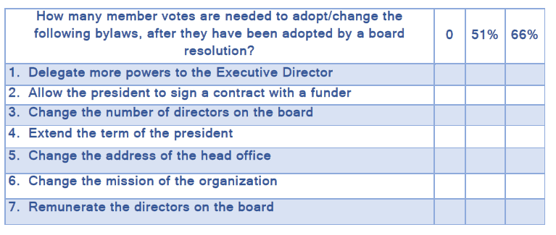
Notes:
0
0
66
0
51
66
66

Slide 27

MEETINGS AND DECISIONS

Slide 28

In the absence of laws or bylaws…
The board adopts resolutions
Notes:
According to the CARVER Model, the board is responsible for overseeing operations at a high, strategic level, in four spheres: vision, policy, performance and governance

Slide 29
Democratic
Robert’s Rules of Order
Roles and Responsibilities of OFFICERS
Did you know:
In some organizations, the ED is always the secretary. This facilitates the administration of meetings and record keeping.
President
Vice-president
Treasurer
Secretary
Notes:
Most decisions are made by majority vote except those related to limiting, extending or ending debates require 2/3 majority
Discussions must keep the “big picture” in mind
Discussions must ensure the corporation continues to have the resources to achieve its mission
The ED is ex-officio on the board (and powers delegated to him as per earlier discussion). The ED has many responsibilities including reporting back to the board, due diligence, as all other officers, knowing applicable laws, implementing the board’s vision.

Slide 30

Consensus
We, the board…
Speaking with one voice
Notes:
Tell the story of how the Kanien’keha:ka of Turtle Island arrive at consensus

Slide 31
Minutes and Resolutions
Public record of proceedings
Effective way of noting decisions made
Important to note resolutions passed, abstentions and situations of conflict of interest when a board member refrains from discussions or decisions

Slide 32

Levels of decision-making

Slide 33
STRATEGY
MISSION
ANNUAL PLAN
MISSION
ACTIVITIES
MISSION
Notes:
Strategic, long term decisions affecting the sustained survival of the organization are within the board’s purview (we already discussed at length decisions that are within the purview of the general assembly)
The annual action plan, stemming from the strategic plan and vision of the board, is within the purview of the ED
The activities are within the purview of the ED and usually implemented by whomever the ED delegates
If a board member runs an activity, they must report to the ED.

Slide 34
Who is responsible for:
Hiring new staff
Preparing the agenda for the board meeting
Signing cheques
Applying for grants
Making decisions on day-to-day operations
Closing for the holidays
Presenting an update at meetings
Knowing the laws that affect employees
Changing bylaws
Meeting with partners
Evaluating the annual plan
Developing new partnerships
Fundraising to ensure sustainable funding for the organization
Representing the organization
Evaluating programs
Trusting staff
Evaluating the strategic plan

Slide 35

Let’s talk budgets
Do you have a financial management policy?
How much spending capacity does the ED have?
Who oversees the auditors?
Do you have an audit committee?
Who decides the budgets that go into grant applications?
Who approves the annual budget?
Notes:
Take a moment and talk about the role of the board of the CISSS in the 1.2 billion dollar budget presented.
Discussion the situation described on page 22 of the board manual
Discuss how adopting an annual plan with an annual budget is a good idea and discuss what types of things should be brought to the board of directors for approval – like honoraria or items not initially in the budget that are above the ED’s purchaing power.

Slide 36


Slide 37
Please answer the questions as they appear on your screen.
Notes:
Click on POLL to do this with the board

Slide 38
Adding value

Slide 39

Top 10 ways to add value as a board member

Slide 40










Slide 41



Slide 42



Slide 43




Slide 44


Good judgement

Slide 45



Slide 46



Slide 47



Slide 48

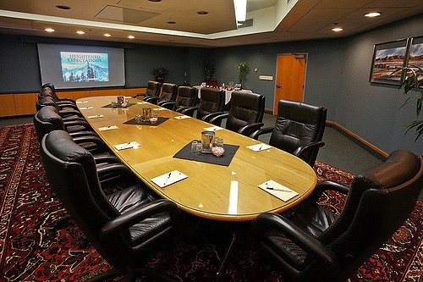
Board evaluation

Slide 49






Notes:
Build relationships by demonstrating trust, support and good listening skills at all levels

Slide 50

Notes:
ALL THE BOARDS responsibilities are connected to the greater public machine and the RESULTS-BASED MANAGEMENT approach. You are, after all, connected to the web of organizations funded with public dollars and you must ensure you achieve the results you are funded to achieve and you add value to society and to the lives of those you serve.

Slide 51
QUESTIONS AND DISCUSSIONS

Slide 52
Next Year’s Orientation Plan
Before the meeting, provide each board member with the manual and all other pertinent documentation
Introductions
Present programs, activities and the whole organization
ED shares the vision for the organization, as adopted by the general assembly and previous boards
President reviews roles and responsibilities of board members
President outlines the upcoming board meeting agenda and answers any questions

Slide 53
WHICH EXERCISES FROM THE MANUAL SHOULD WE TRY TOGETHER?

Slide 54
DID we ACHIEVE THE OBJECTIVES?
LEARN SOMETHING NEW ABOUT YOUR FELLOW BOARD MEMBERS
UNDERSTAND GOOD GOVERNANCE AND THE DIFFERENT MODELS OF GOVERNANCE
BE ABLE TO LIST THE LEGAL OBLIGATIONS OF BOARD MEMBERS IN QUEBEC
BETTER UNDERSTAND YOUR ROLE AS AN INDIVIDUAL BOARD MEMBER
GAIN PRACTICAL KNOWLEDGE ABOUT OPERATIONS ON THREE LEVELS
GAIN PRACTICAL TOOLS TO ENABLE YOU AND NEW BOARD MEMBERS TO ADD VALUE TO YOUR BOARD OF DIRECTORS AND TO YOUR ORGANIZATION
P
P
P
P
P
P

Slide 55



